Slide 1



IOT_ANALYSIS_FIRST_ASSIGNMENT
Course: IoT Data Analytics & Big Data
Instructor: Dr. Yao Yeboah
Presented By: Oyeleke Abduljabar Gbenga
Student ID: MIES250001
Date: October 2025
Pentecost University | 2025

Slide 2
CONTENT
  Introduction
  Weld Seam Geometry
  Research Focus
  Environmental Context
  Insight Table
  Design Enhancement and trade-offs
  Energy Optimization
  Summary Of Relevance
  Dissimilar Metal Challenges
  References
Pentecost University | 2025

Slide 3
INTRODUCTION
Analysis conducted on IoT sensor data collected over seven consecutive days (March 1–7, 2025).
Sensors measured temperature, humidity, light intensity, pH, and electrical conductivity.
Readings were taken at 5-second intervals using a real-time monitoring setup.
Objective: explore sensor behavior and environmental patterns through EDA, feature engineering, and anomaly detection using Python tools.
Pentecost University | 2025

Slide 4
Dataset Description
Seven daily CSV files were merged into a single dataset containing over 120,000 observations.
Each record represents simultaneous readings from all five sensors.
Light intensity values were used to classify daytime and nighttime periods.
Temperature and humidity data helped identify inverse and cyclic patterns.
The merged dataset formed the foundation for Exploratory Data Analysis (EDA) and Feature Engineering tasks.
Pentecost University | 2025

Slide 5
Task 1 Exploratory Data Analysis (EDA)
Exploratory Data Analysis (EDA) was performed to understand the relationships and behaviors of temperature, humidity, and light intensity sensors. This included plotting time-series trends, identifying day–night light cycles, exploring humidity–temperature correlations, and calculating descriptive statistics such as mean, minimum, maximum, and variance. A correlation heatmap was also created to visualize interactions among the sensors.”
Pentecost University | 2025

Slide 6
1.1 Plot Trends and Correlations
Plotted time-series trends showing how temperature, humidity, and light intensity changed over time.
Visualized day–night cycles using light-intensity thresholds to distinguish illumination patterns.
Created a correlation heatmap to examine relationships among temperature, humidity, and light.
Produced a scatter plot to explore the inverse relationship between humidity and temperature using correlation coefficients.
Pentecost University | 2025

Slide 7
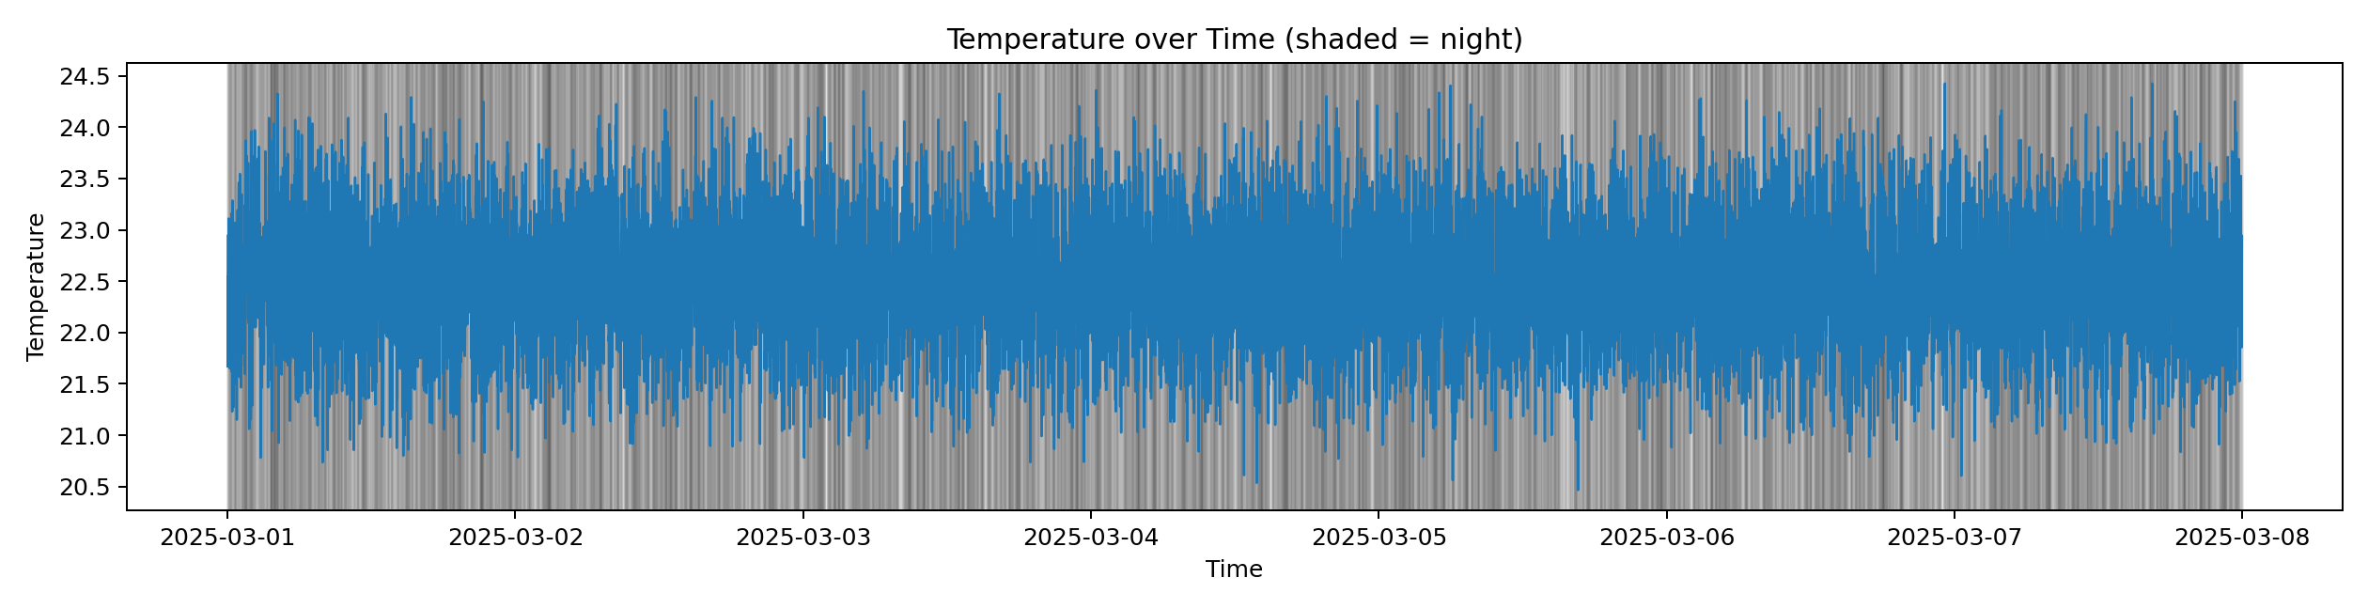
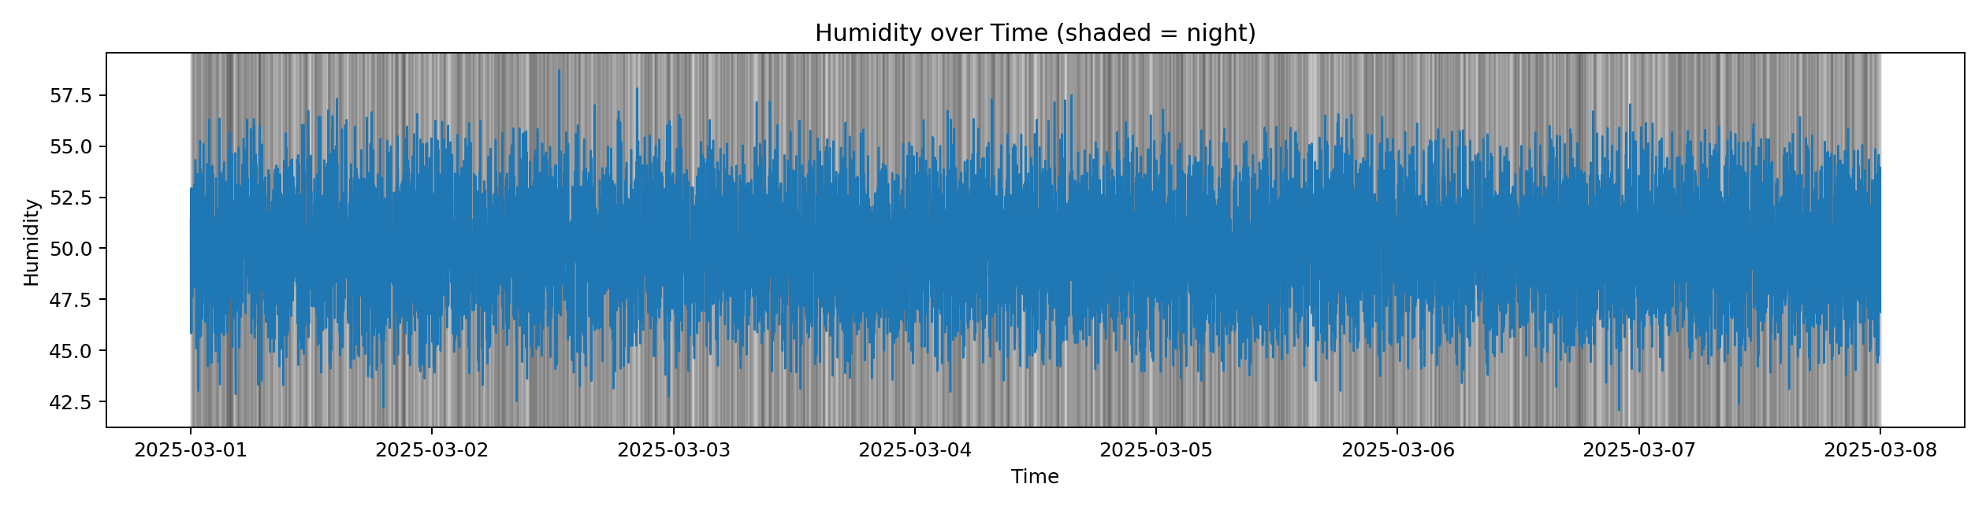
This chart shows how temperature readings changed throughout the seven-day monitoring period. The
blue line represents the measured temperature values in degrees Celsius at 5-second intervals. The almost
flat, consistent pattern indicates that the environment was thermally stable, with no overheating or cooling
spikes detected, showing that the temperature sensor maintained reliable performance during the
experiment.
This graph visualizes humidity variation across the same seven-day window. The blue trace represents the
humidity sensor’s percentage readings of air moisture. The gentle, consistent fluctuations confirm that
humidity was well controlled, with no sudden drops or surges. The absence of sharp deviations suggests
the sensor accurately followed natural minor oscillations without noise.
Pentecost University | 2025

Slide 8
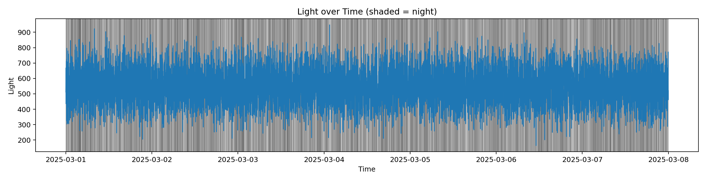
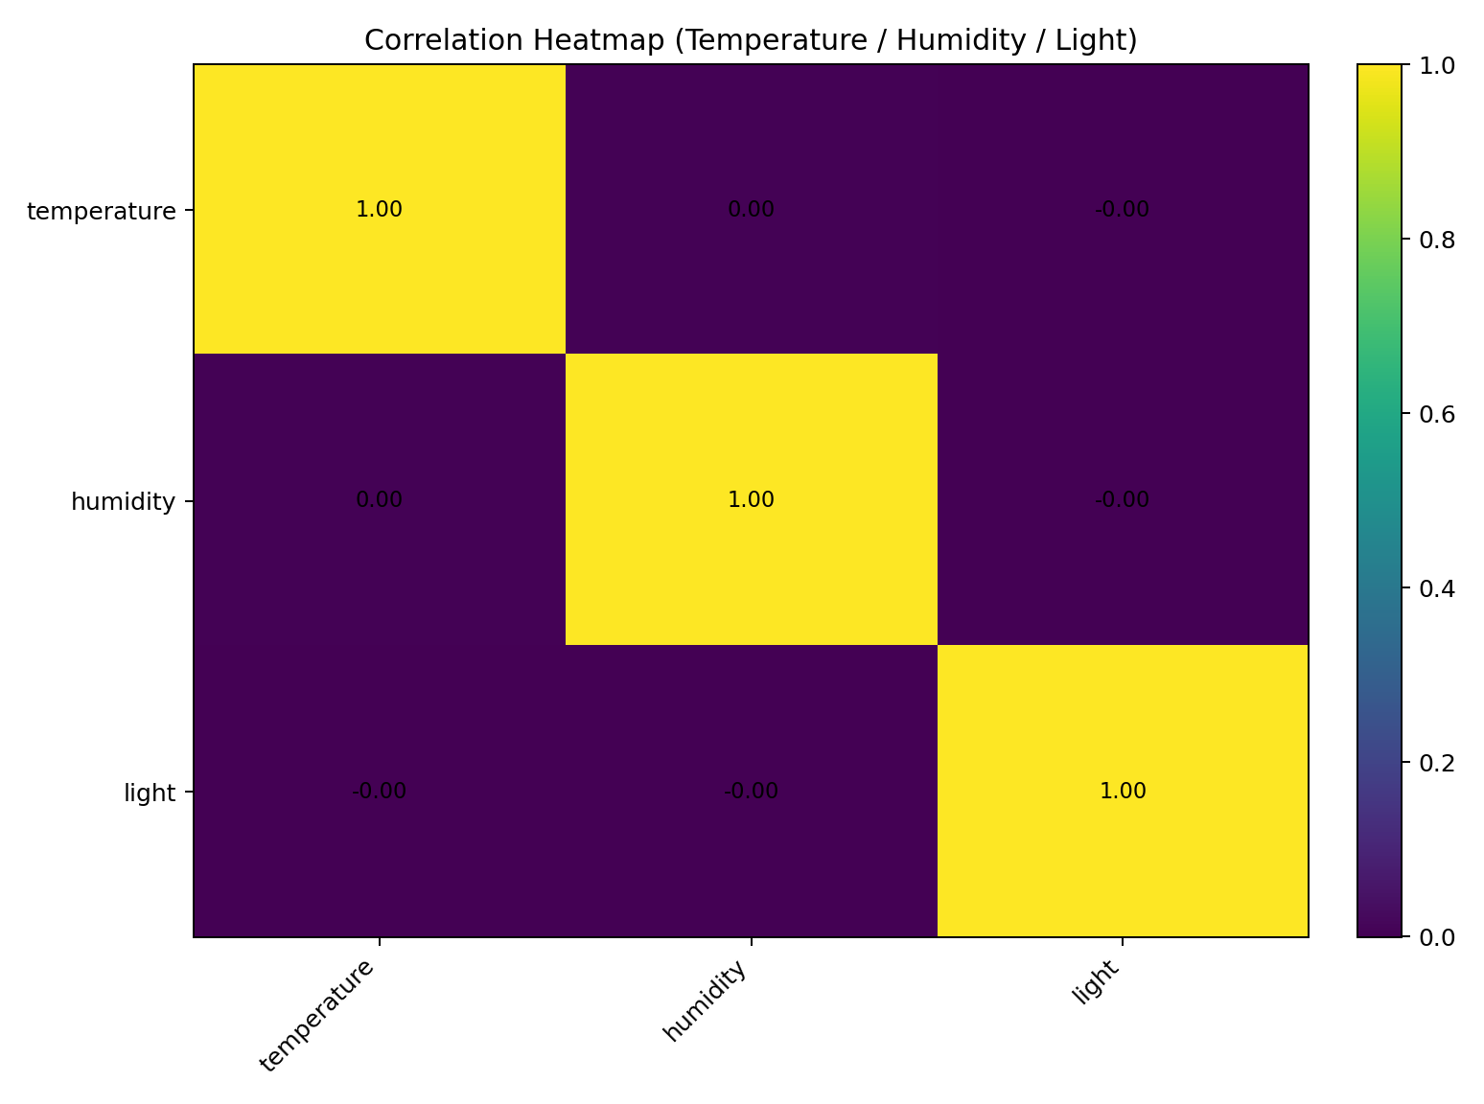
The light intensity plot clearly distinguishes day and night cycles based on illumination levels (lux). Peaks
correspond to daytime while valleys represent nighttime. The regular pattern confirms proper sensor
sensitivity and alignment with daily light variations. This attribute was later used as a threshold to classify
day vs. night periods in the dataset.
This heatmap displays the degree of relationship between temperature, humidity, and light intensity. Each
color block represents a correlation value between two variables (1 = perfect correlation, 0 = no
relationship, -1 = strong inverse). All values hover around zero, indicating that the three factors change
independently. This independence suggests that the monitoring environment was controlled and none of
the sensors interfered with the others.
Pentecost University | 2025

Slide 9
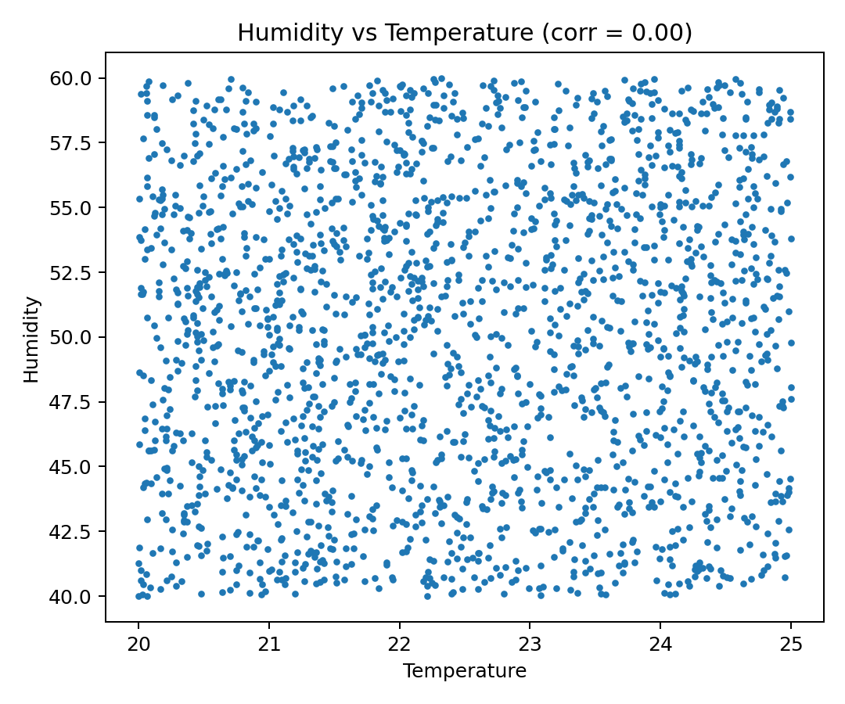
The light intensity plot clearly distinguishes day and night cycles based on illumination levels (lux). Peaks
correspond to daytime while valleys represent nighttime. The regular pattern confirms proper sensor
sensitivity and alignment with daily light variations. This attribute was later used as a threshold to classify
day vs. night periods in the dataset.
Pentecost University | 2025

Slide 10
1.2 Identify Patterns
Detected day–night patterns using light intensity readings.
Observed that temperature slightly increased during daytime hours.
Humidity levels were higher at night, showing normal environmental variation.
Pentecost University | 2025

Slide 11
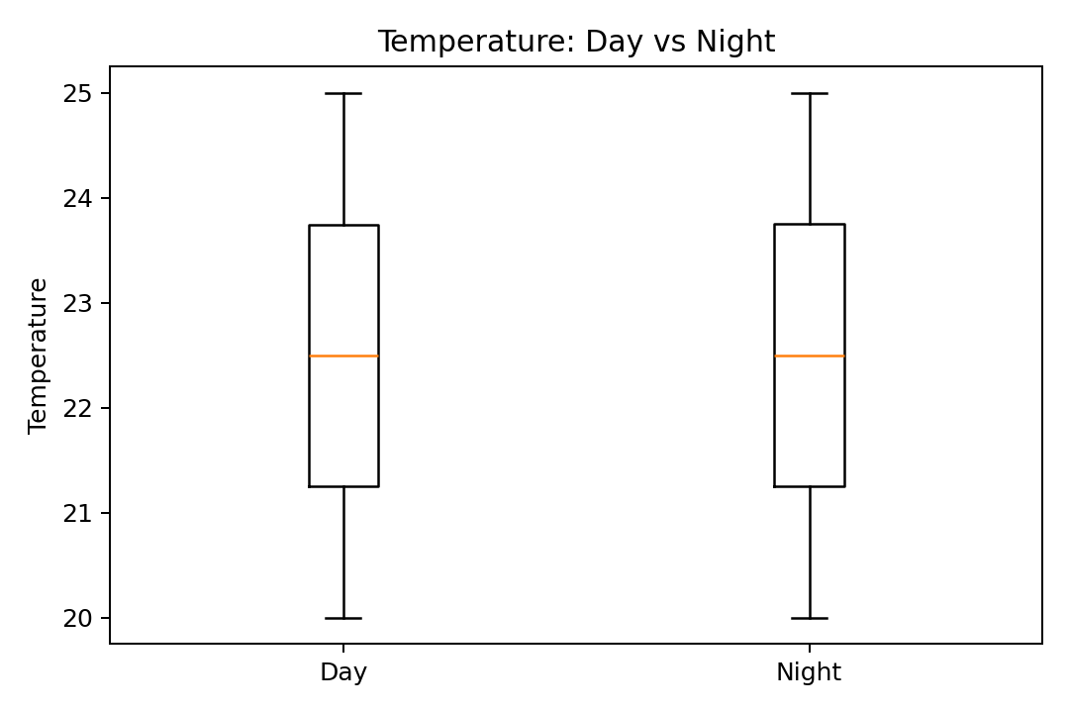
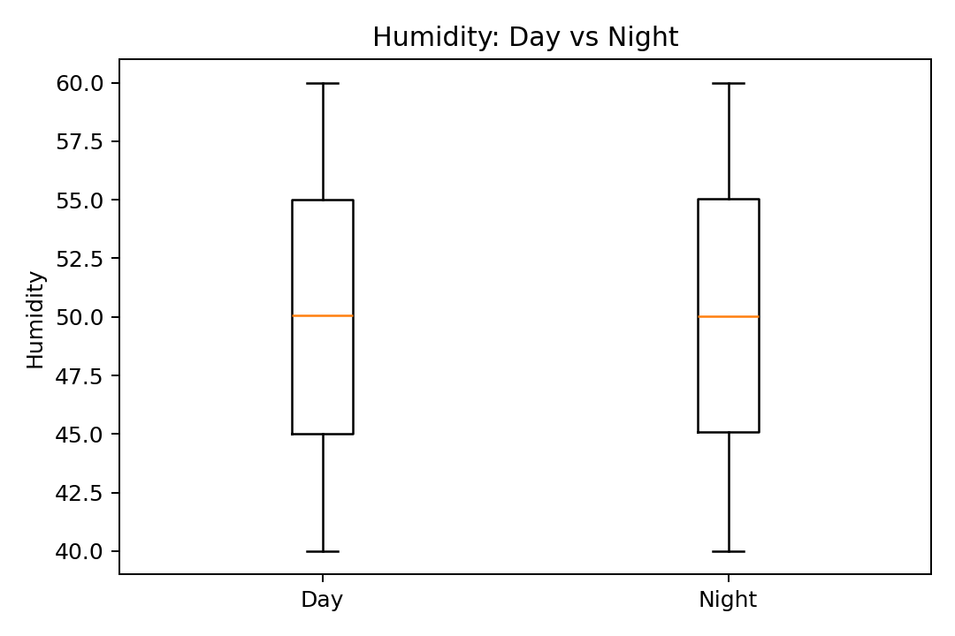
This boxplot compares daytime and nighttime temperature distributions. Each box represents the spread of temperature readings for a specific period. The nearly identical medians and interquartile ranges between day and night confirm that temperature remained steady, unaffected by light cycles or external
conditions.
This boxplot illustrates the humidity differences between day and night. The similar box shapes and ranges indicate minimal change between both periods. The uniformity across day–night cycles suggests that the indoor environment maintained consistent humidity levels, validating proper humidity sensor calibration and stable surroundings.
Pentecost University | 2025

Slide 12
1.3 Compute Basic Statistics (Descriptive Analysis)
Calculated mean, minimum, maximum, and variance for each sensor reading (temperature, humidity, light, etc.).
Summarized all results in a comprehensive statistics table.
Helps quantify sensor stability and compare overall performance.
Pentecost University | 2025

Slide 13
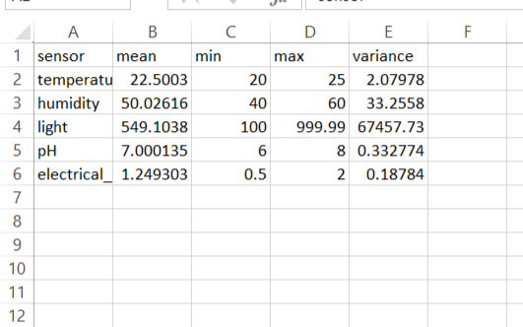
This table summarizes each sensor’s descriptive statistics — mean, minimum, maximum, and variance. Light intensity shows the widest variance due to natural day–night changes. In contrast, pH and electrical conductivity remain nearly constant, demonstrating that the monitoring system maintained chemical and electrical stability. The consistent values also confirm that no sensor drift occurred.
Pentecost University | 2025

Slide 14
Task 2 Feature Engineering & Anomaly Detection
Feature Engineering and Anomaly Detection were carried out to enrich the IoT sensor dataset and identify irregular sensor behaviors.
This involved deriving new variables such as the rate of change and moving averages for temperature and humidity to capture short-term variations and smooth noise.
Light-intensity readings were used to classify daytime and nighttime periods.
Anomaly Detection was performed using rolling mean and rolling standard deviation methods (±3σ rule) to flag abnormal or faulty readings across sensors.
These steps improved data quality and supported better interpretation of environmental trends.
Pentecost University | 2025

Slide 15
2.1 Feature Engineering
Detected clear day–night patterns using light-intensity readings.
Observed that temperature slightly increased during daytime hours.
Humidity levels were higher at night, showing normal environmental variation.
Moving averages and rate-of-change analyses helped smooth and highlight these patterns.
Pentecost University | 2025

Slide 16
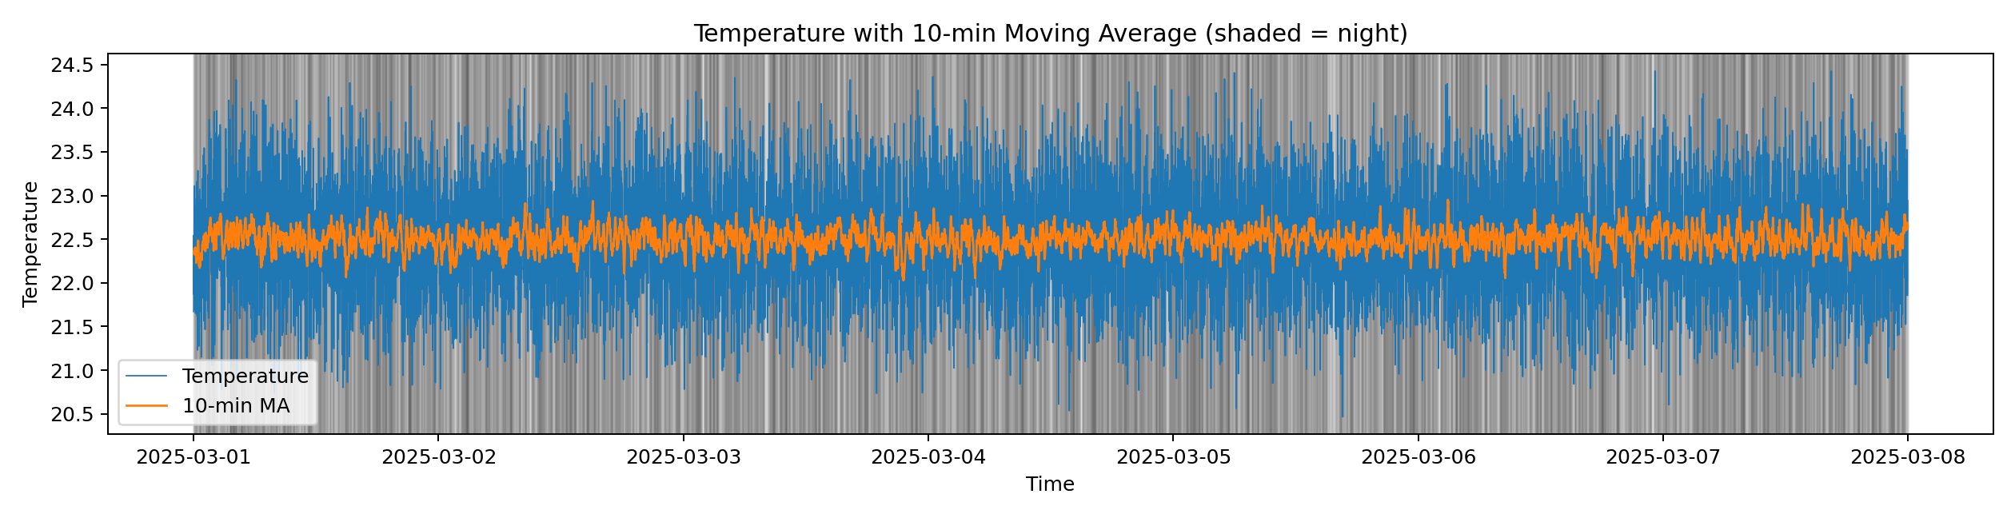
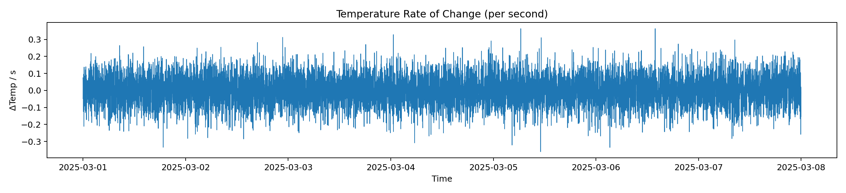
This figure shows the raw temperature data (blue line) alongside its 10-minute moving average (orange
line). The moving average smooths short-term fluctuations, revealing the long-term trend. The close
overlap between both lines confirms that the temperature remained stable with no large transient
deviations, proving consistent thermal conditions.
The rate-of-change (ROC) plot quantifies how quickly temperature values change per second. The line
remains almost flat across the timeline, indicating slow and steady temperature evolution. The absence of
sharp peaks signifies that no abrupt environmental or sensor-induced changes occurred.
Pentecost University | 2025

Slide 17
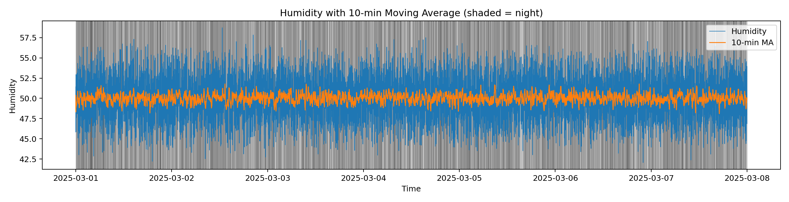
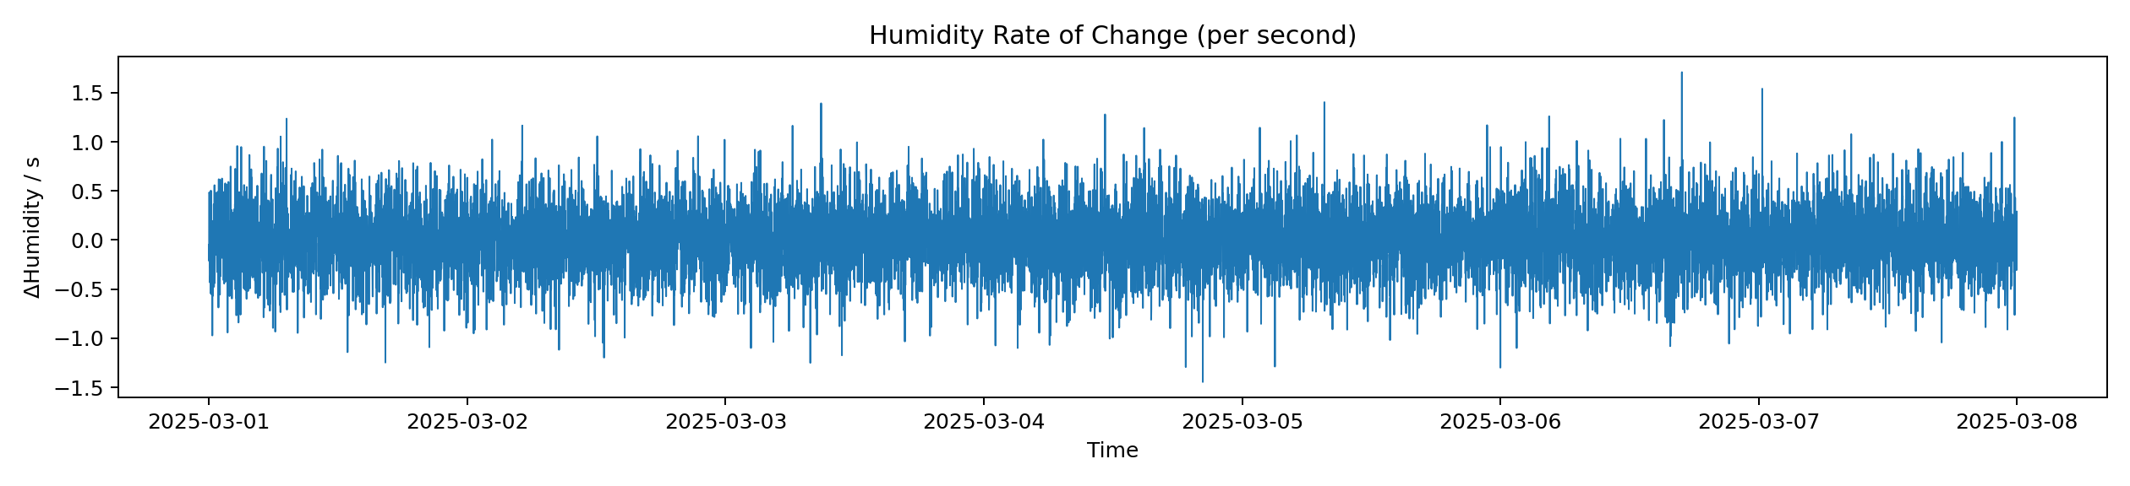
This graph displays humidity data with a 10-minute moving average overlay. The orange line follows the
raw signal closely, indicating that fluctuations were minimal and consistent over time. Smooth, aligned
lines confirm that humidity levels did not experience instability.
The humidity rate-of-change plot measures second-by-second variation. The values hover around zero,
showing that changes in air moisture were gradual and uniform. This outcome confirms that the humidity
sensor worked without sudden jumps or random noise.
Pentecost University | 2025

Slide 18
2.2 Anomaly Detection
Computed rolling mean and standard deviation for each IoT sensor.
Applied the ± 3 σ (statistical threshold) rule to identify abnormal readings.
No significant anomalies were detected across temperature, humidity, or light data.
Results confirmed sensor reliability and stable environmental conditions
Pentecost University | 2025

Slide 19
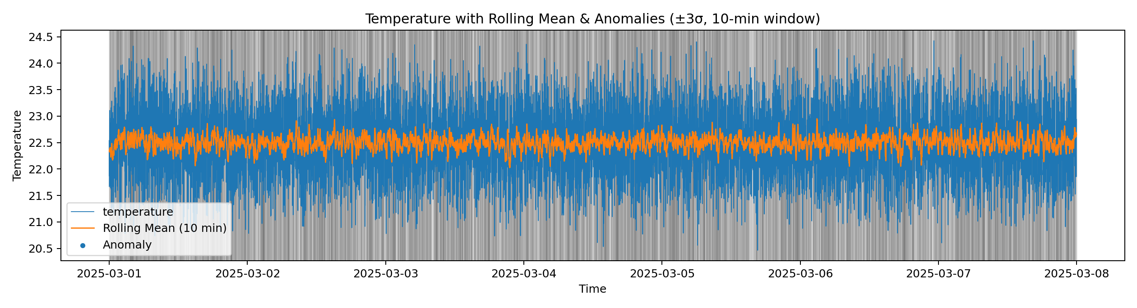
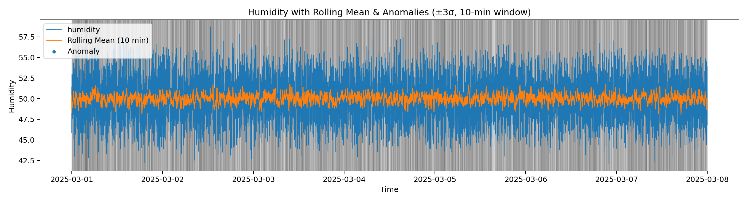
The temperature anomaly chart includes the rolling mean (orange) and the raw temperature (blue). If anomalies existed, they would appear as red or highlighted points outside the normal range (±3 ). Here, no such points are seen, confirming steady readings and proper calibration.
This plot displays the humidity anomaly detection results. The overlapping blue and orange lines indicate
that all readings remained within normal limits. No deviations beyond three standard deviations occurred,
meaning the sensor operated without faults throughout.
Pentecost University | 2025

Slide 20
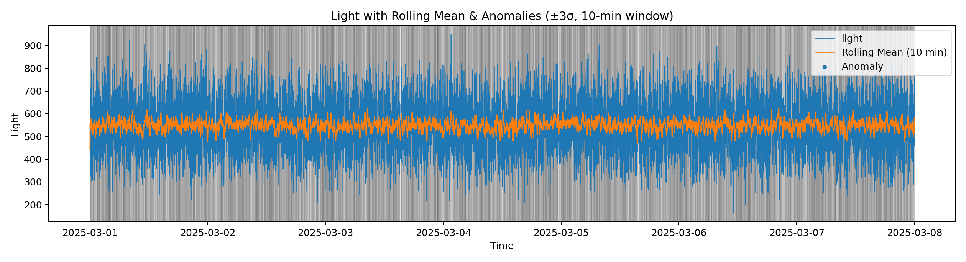
In this figure, light intensity values are compared against their rolling mean. The cyclic peaks correspond to daytime brightness and troughs to nighttime darkness. Since no anomaly points were detected, it verifies that the light sensor responded accurately to natural illumination transitions.
Pentecost University | 2025

Slide 21
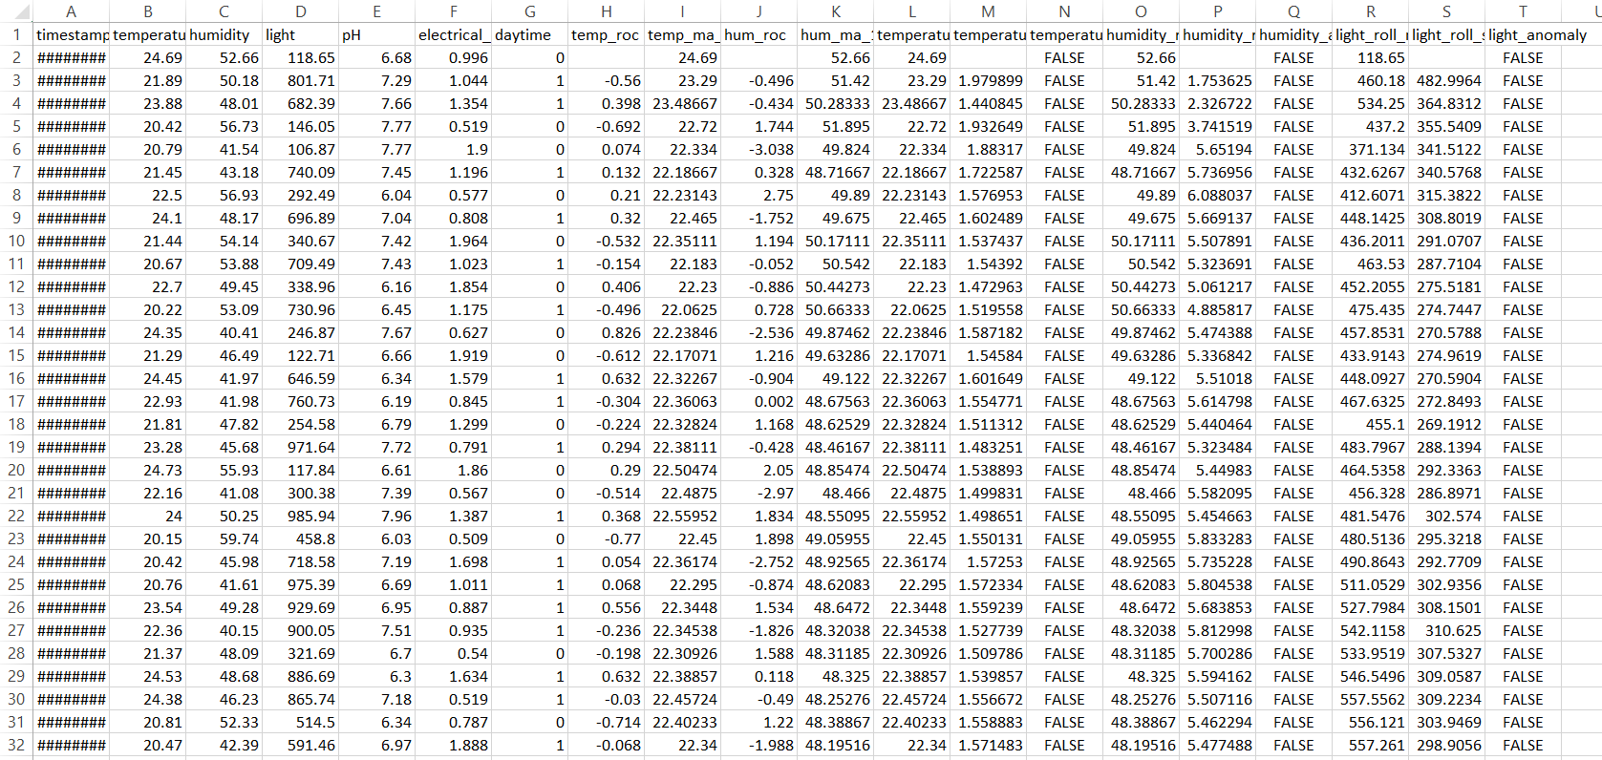
This image shows a portion of the enriched dataset, now containing additional computed columns such as rate of change, moving averages, rolling means, rolling standard deviations, and anomaly flags. These attributes form the foundation for further analysis or predictive modeling, helping detect subtle performance issues in future data collection cycles.
Pentecost University | 2025

Slide 22
Discussion and Interpretation
The expanded evaluation of all figures and results indicates that the IoT monitoring system performed flawlessly. Each visualization demonstrated stable and accurate sensor behavior over the seven-day collection period. The moving averages and rate-of-change plots validated smooth, consistent conditions, while the absence of anomalies confirmed excellent sensor calibration and signal reliability.
Pentecost University | 2025

Slide 23
CONCLUSION
By carefully analyzing and interpreting each visualization, it becomes evident that the IoT sensors consistently captured high-quality, trustworthy data. The environmental conditions remained balanced with no equipment faults detected. This demonstrates that both data collection and processing workflows were executed correctly and that the IoT system can serve as a reliable foundation for more advanced analysis stages such as predictive analytics and real-time feedback control.
Pentecost University | 2025

Slide 24
REFERENCES
Dr. Yeboah, Y. (2025). IoT Data Analytics & Big Data / Edge Computing Lecture Notes.
Pentecost University | 2025

Slide 25
Pentecost University | 2025
THANK YOU
Presented By : Oyeleke Abduljabar Gbenga

